Slide 1


Advocacy in Action
Session 1

Slide 2
Legends
Grass Roots
Inspire
Foster Care
Speak Up
Launch

Slide 3
Speak Up

Slide 4
Speak Up!
Action Behind Advocacy

Slide 5

Consider…
Who cannot speak up for themselves?
Who is pushed aside in society?
What happens if no one speaks up?
When you speak up, who listens?
Who speaks the loudest?

Slide 6

What do we need?
Someone who…
SPEAKS UP!
Wants to support positive change
Poses a challenge: why can't we do better?
Believes the future will be better if we all work for a better future.
An
Advocate

Slide 7
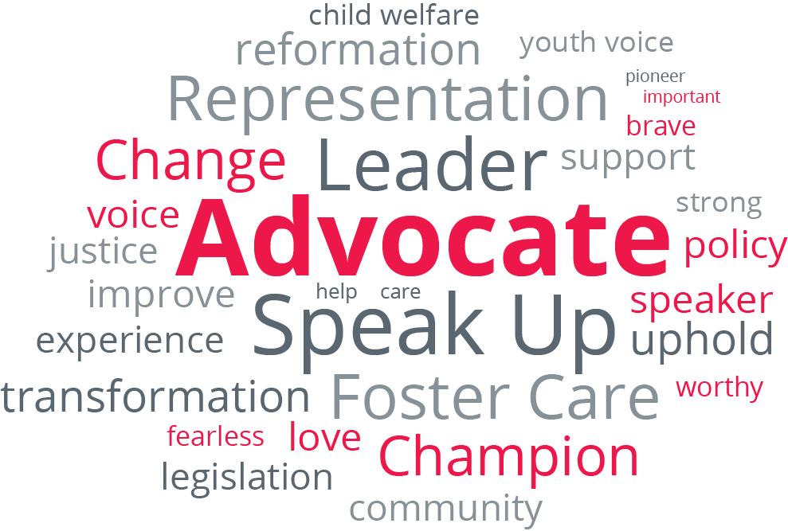


Slide 8
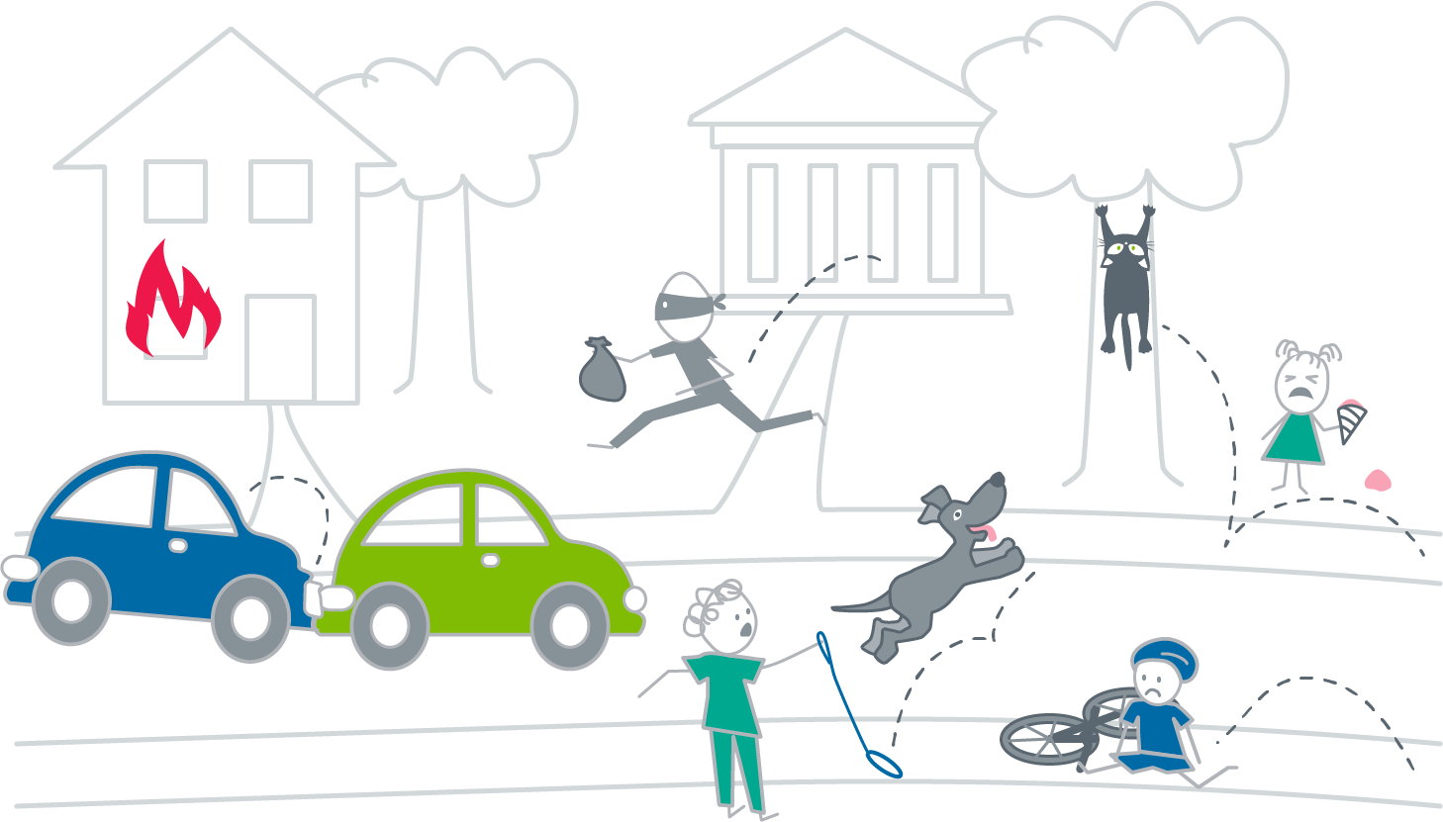

Slide 9

Your tools, specific to your strengths
Your personal values, thoughts & ideas
=
A uniquely
valuable
Advocate
Your unique perspective
Notes:
Advocacy is a unique, personal journey. Every advocate has a unique perspective, their own values and different tools and strengths that make each advocate valuable, in different ways. Think of your advocacy as an expression of yourself, what you care about, and the change you want to see in the world. Your journey as an advocate is unique to you.

Slide 10

Are you ready to
Speak Up?

Slide 11
Speak Up:
Voices for Foster Care Reform
Trains and empowers advocates, particularly current and former foster youth.
Notes:
Fostering Great Ideas strives to improve the lives of children impacted by foster care. Our Speak Up program trains and empowers advocates, particularly current and former foster youth.After you take this training you are eligible to join our Speak Up community. We will keep you posted on advocacy efforts through our organization and give you tools to explore your advocacy on your own, or with a great partner organization that aligns with your values and location.

Slide 12
Additional Trainings
Changing Policy and Passing Legislation
Boardroom Bootcamp
Finding your voice: The power of telling your story
Notes:
Fostering Great Ideas strives to improve the lives of children impacted by foster care. Our Speak Up program trains and empowers advocates, particularly current and former foster youth.After you take this training you are eligible to join our Speak Up community. We will keep you posted on advocacy efforts through our organization and give you tools to explore your advocacy on your own, or with a great partner organization that aligns with your values and location.

Slide 13
Legends
Grass Roots
Inspire
Foster Care
Speak Up
Launch

Slide 14
Inspire

Slide 15

Are you ready
to do something
BIGGER?

Slide 16
“Have the courage to follow your heart and intuition. They somehow already know what you truly want to become."
~ Steve Jobs
"In order to be irreplaceable, one must always be different."
~ Coco Chanel
"You may say I'm a dreamer, but I'm not the only one."
~ John Lennon
(grew up in kinship care)
"I've always had confidence. It came because I have lots of initiative. I always wanted to make something of myself."
~ Eddie Murphy
(entered foster care at birth and was adopted as a baby)
(spent her teen years in an orphanage)
Stop holding your truth; SPEAK YOUR TRUTH! Be yourself, it's the healthiest way to be."
~ Tiffany Haddish
(former foster youth)
(former foster youth)
Notes:
Our focus is Foster Care, but we recognize that your advocacy, and the skills you learn here, can be used for other issues that you are passionate about.
Tell us what issues light your fire!

Slide 17

What do
YOU
care about?

Slide 18

Self Care
Notes:
Caring deeply, as advocates do, can be very draining emotionally. This is particularly true when we are advocating for issues that are very personal, like foster care.
Little self care breaks are important, we are going to take one now!
Get some water, stretch your legs a little, go outside for a minute if you can.

Slide 19
Legends
Grass Roots
Inspire
Foster Care
Speak Up
Launch

Slide 20
Legends

Slide 21
Legends
past
present

Slide 22
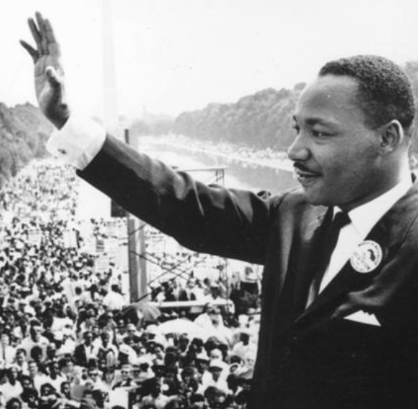
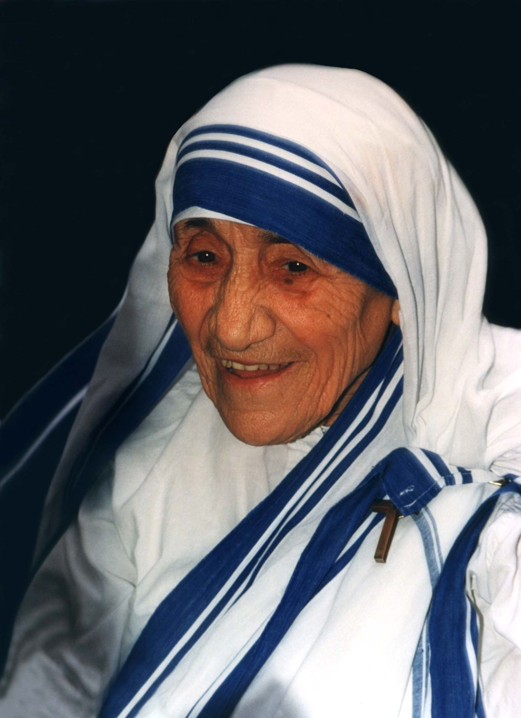
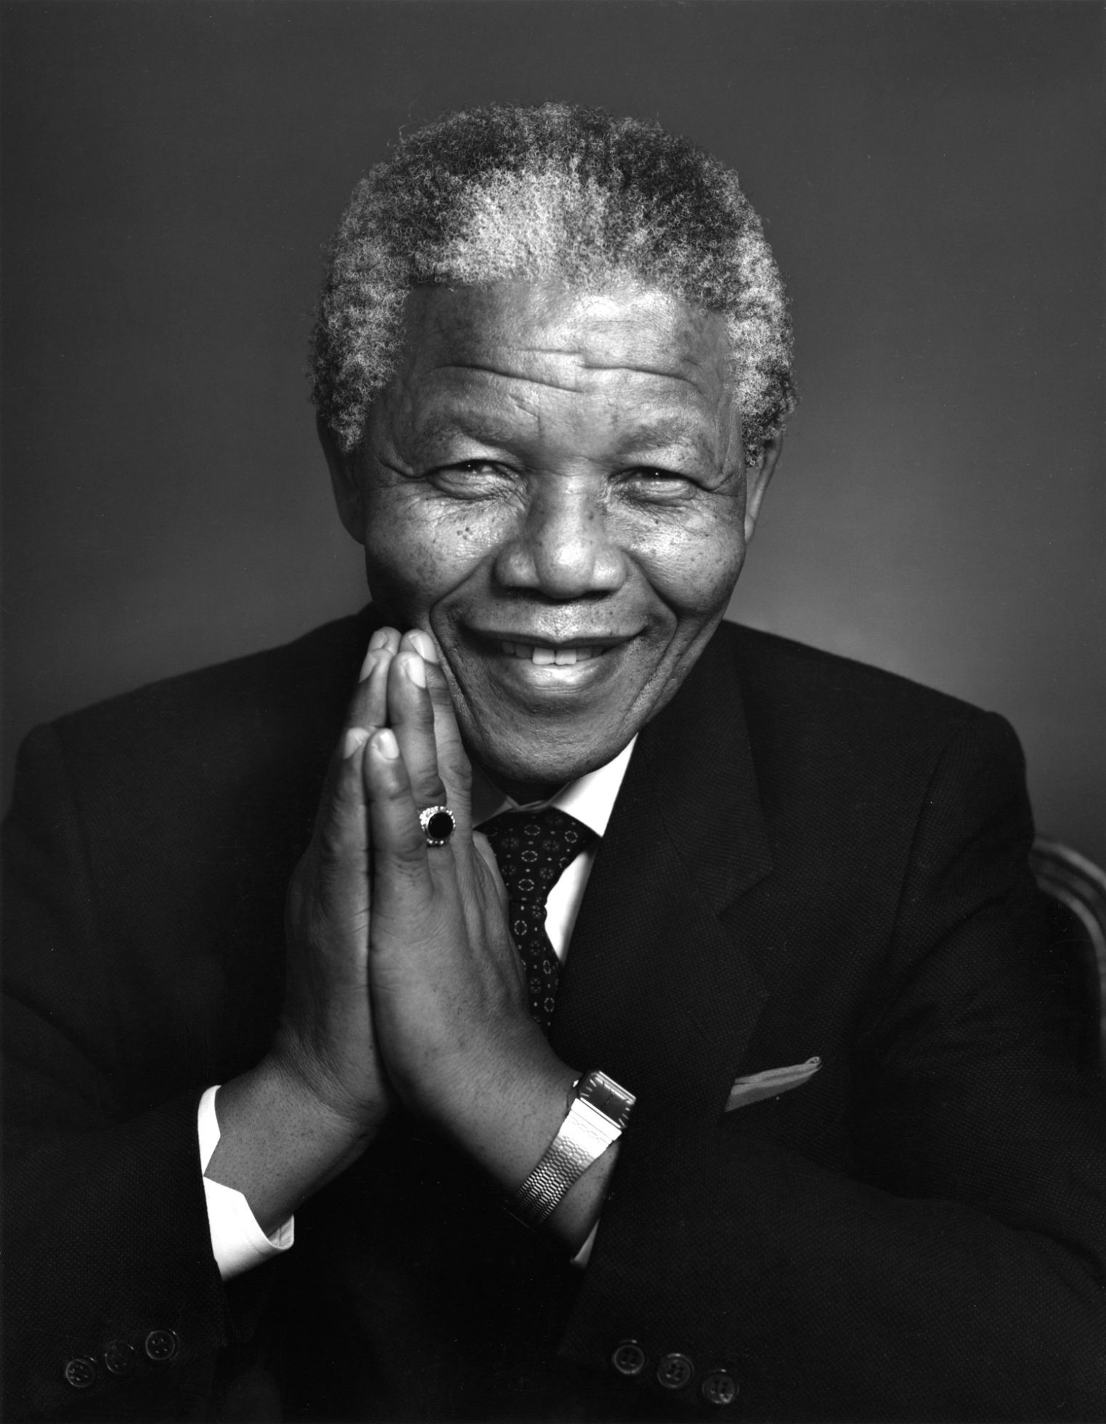
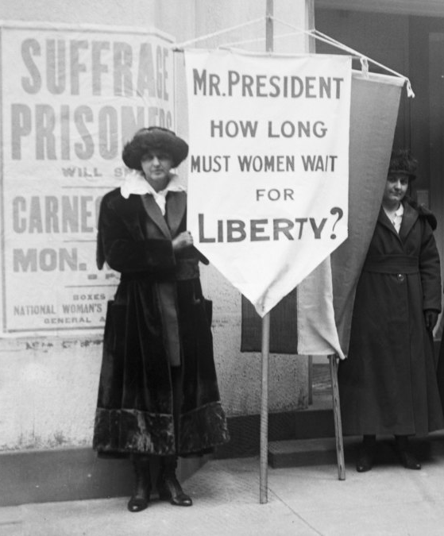
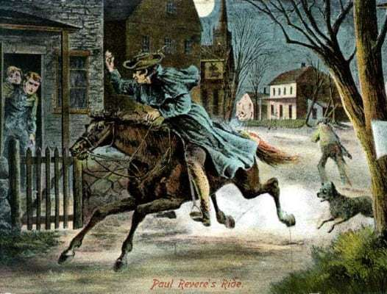
Famous Advocates
Notes:
Which Advocates do you admire? What makes them great?

Slide 23

Current Advocates
Who do you admire?
Who do you see out there changing the world?
Notes:
Take a few minutes to pick one advocate who is alive today and share.

Slide 24

Who Can You Reach?
Existing alumni platforms:
Speak Up
FCAA
NFYI
Foster Club
Foster Youth in Action
CCAI
Mocking Bird Society
Youth MOVE National
Notes:
Consider how the advocates today have vastly different platforms from historical advocates.
Today we have internet, social networks, immediate international access to books, videos, articles, etc.
What platforms can you use for advocacy? When you are starting out it might just be journaling or speaking with people you trust.
Existing alumni platforms:
Speak Up
FCAA
NFYI
Foster Club
CCAI
Mocking Bird Society
Youth MOVE National

Slide 25
People Like Me
These influential people were in foster care. We want to introduce you to them!
Notes:
(Video of alumni advocates)

Slide 26

Who will history
remember
from this time?
Notes:
Which Advocates do you admire? What makes them great?

Slide 27
It could be YOU!

Slide 28
Legends
Grass Roots
Inspire
Foster Care
Speak Up
Launch

Slide 29

fgi4kids.org
Thank you for participating!

Slide 30
Advocacy in Action
Session 2

Slide 31
Legends
Grass Roots
Inspire
Foster Care
Speak Up
Launch

Slide 32
Grass Roots

Slide 33

Getting Back to our Grass Roots
Notes:
Foster care is in the midst of a grassroots movement led by foster youth and alumni.

Slide 34
“The little grassroots people can change this world.”
~Wangari Maathai
Notes:
Foster care is in the midst of a grassroots movement led by foster youth and alumni.

Slide 35




Level Up!
Notes:
Grassroots movements are all about ordinary people coming together to enact change. The alumni movement in foster care is a social movement led by people who have experienced foster care personally and want to use their experience, their stories and elevate their collective voices to change the way the system works to help the children who follow in their footsteps.
For some of you, today is your first day on the job, others have been working on their piece of the solution. Think of social movements as a machine, each person plays an important role, at the level they can have the most impact. Just like in a video game, the more you play the faster you level up.

Slide 36
The Foster Care Movement
Can we make it perfect?
Probably not.
Can we make it better?
Indeed!
Notes:
Critical changes have been made to foster care in the last 20 years, led by former foster youth who recognize the system they grew up in can be better and the children following in their footsteps, can have a better foster care experience.

Slide 37
Thought Project
How would you make foster care better?
When kids enter foster care
When placements change
When kids leave foster care
Notes:
Take a few minutes to brainstorm, how would you make foster care better? *Trigger warning, this can be tough, the chill room is available.

Slide 38
Legends
Grass Roots
Inspire
Foster Care
Speak Up
Launch

Slide 39
Foster Care

Slide 40
Foster Care
The Necessary Journey

Slide 41
Change starts within YOU.
You are already an advocate.
Step #1
Introspection

Slide 42
Change starts within YOU.
You are already an advocate.
Step #1
Introspection
Step #2
Learn from others

Slide 43
Change starts within YOU.
You are already an advocate.
Step #1
Introspection
Step #2
Learn from others
Step #3
Organize or join an organization

Slide 44
Change starts within YOU.
You are already an advocate.
Step #1
Introspection
Step #2
Learn from others
Step #3
Organize or join an organization
Step #4
Repeat

Slide 45

Step 1: Look Inside Yourself

Slide 46
Step 1: Look Inside Yourself
What part of foster care is most difficult?
Do you think kids still struggle with that?
Can that change?
Notes:
Ask Yourself... (introspection)
What part of foster care is most difficult?
Do you think kids still struggle with that?
Can that change?
Use this process of introspection to discover the issues that you care deeply about.

Slide 47

Step 2: Learn from Others

Slide 48
Step 2: Learn from Others
Research
Connect with other foster youth/alumni
Notes:
Part 1- Research. Find your issue. See what has already been done in other states, understand where your state is positioned on the issue. We have a tool that can help, our Speak Up App!
Part 2- Connect with other foster youth/alumni. Ask: Was this a challenge you experienced too?How can we make it better? Do you see any solutions?We encourage you to connect with other advocates at our monthly events and through the Speak Up App!

Slide 49

Step 3: Find Kindred Spirits

Slide 50
Step 3: Find Kindred Spirits
Connect with other advocates
Create a strategic plan with S.M.A.R.T. goals
Notes:
Are other advocates working on this issue? That should inspire you, not scare you. We have better outcomes when we work together. Grassroots advocacy can start with a single person and their idea. One person can only do so much, it is important to organize into a collective to have the largest impact. If any other advocates are already working on this issue, consider joining them, if not, start your own group or bring your idea to an advocacy group like Speak Up! We can help you create a strategic plan with S.M.A.R.T. goals and connect with other advocates.
Remember our voices are amplified when we Speak Up together and unite behind a common goal. Collective impact!

Slide 51

Step 4: Repeat!

Slide 52
Step 4: Repeat!
Take the step
Take another step
If you start to feel burned out, start over at introspection to remind yourself why you became an advocate.
Notes:
Reformation does not happen over night, it takes a million baby steps, each one matters!
Take the step! Then take another step! If you start to feel burned out, start over at introspection to remind yourself why you became an advocate.

Slide 53
Legends
Grass Roots
Inspire
Foster Care
Speak Up
Launch

Slide 54
Launch

Slide 55
Launch
Communication is the Key to Advocacy

Slide 56



How do you communicate?
Notes:
Play to your strengths as an advocate! How do you communicate?
Verbal- Testify on bills, sit on panels or task forces, call your representatives, share advocacy efforts on social media with videos.
Written- Writing your representatives, blogging or writing an op-ed, share your story through poetry or narrative, share advocacy efforts on social media.
Collective Communication- Coming together with other advocates and uniting your voices to amplify your message.

Slide 57
Speak Up App
The App that helps you Speak Up!
As a certified foster care advocate, you have exclusive use of our advocacy tool.
Notes:
The App that helps you Speak Up!As a certified foster care advocate, you have exclusive use of our advocacy tool Speak Up App. This app allows advocates to stay up to date on the foster care issues they care about and contribute to our collective mission; to improve foster care.

Slide 58

What type of Advocate are you?
Take our Advocate assessment:

Slide 59

Your personal brand
How do you want people to remember you?
Does the way you present yourself reflect the values you hold?
Are you prepared?
Notes:
*Even if it isn't important you what other people think it should matter how you think of yourself. The way you present yourself is a reflection of who you are.
We as humans are ever evolving, our values change as does our personal brand. Making sure the two are in line is important.
Remember Watch-Listen-Prepare. Watch what is happening or what has happened through reflection and research. Listen to people personally effected, especially if they have a different perspective. Prepare your perspective so you are ready to discuss it.
*Being prepared helps build your confidence. Know the issues, do your research, prepare any statements beforehand and check in with yourself emotionally- advocating can be triggering.

Slide 60

Listen up!
Open-ended questions
Dignity and respect
Empathy
Notes:
You can't be an effective advocate until you balance speaking up with listening up!
Try to listen to others to understand, not just to respond.
*Ask open ended follow up questions to deepen your understanding. You can disagree and still affirm the other person.
*Dignity and respect are shown through thoughtful listening. When responding try to be reflective of the information you just heard and respond thoughtfully. *Always show empathy.

Slide 61

Check yourself
Understand how our personal perspectives and bias can influence the way we think and feel.
Notes:
Everyone has bias, even the most woke people see the world through their own perspective.
Each of our perspectives are different because they are shaped by many contributing factors including experiences growing up and cultural norms.
It is important to recognize your bias, not necessarily to make it go away (some bias' make sense) but to understand yourself more completely and when we understand our bias, and you regularly CHECK YOURSELF to control your triggers and try to understand how your bias might impact your perspective and actions.
Can we do the bias assessment as a poll here?

Slide 62
Advocate!
Join Speak Up
Advocacy coaching session
Introspection
Your story & ideas
Join advocate connections
Remember someone who cared
Speak Up App bill tracker
Call your state legislator
Join a board or action group
Run for an elected office
Notes:
What Can I do next? On a scale of 1 to 10 from Sure to Scary!
Join the Speak Up community of advocates.
Do a 1:1 free advocacy coaching session.
Introspection, figure out why you care.
Write down your story and your great ideas for how to improve the system.
Join one of our monthly advocate connections.
Remember an adult who cared deeply for you, or spoke up for you. Would you consider contacting that person? That might be a great way to connect with your WHY and hear another perspective.
Check the Speak Up App bill tracker for a bill that interests you.
Call your state legislator. Simply state, “I have lived in foster care. May I tell you what it is like?”
Join a Board or action group in your area.
Run for an elected office.
Stay connected through the Speak Up App at the level that best suits you.

Slide 63




Stay Connected, We Will Too!
Speak Up is a community of advocates working together to improve foster care. YOU are an important part of this mission.
fgi4kids.org
Notes:
Of course you now have access to the speak up app, you also have my contact information and we will be following up after training with a survey (includes in interested in being contacted about ...)and a reminder of your next steps!
In the next three months please try to schedule your free coaching session.

Slide 64

Don’t limit your challenges, challenge your limits!
Notes:
Believe in yourself, we believe in you. You have a story that matters and a voice that needs to be heard!

Slide 65
fgi4kids.org
Thank you for participating!

